Slide 1
Massive Effects of Saliency on Information Processing in Visual Working Memory
Martin Constant & Heinrich R. Liesefeld
LMU München
Virtual Working Memory Symposium
04/06/2020
This work is licensed under a “Creative Commons Attribution 4.0 International” license.

Slide 2
Visual Working Memory
Mental workspace
Limited capacity
Two experimental tasks:
Change detection
Continuous report

Slide 3
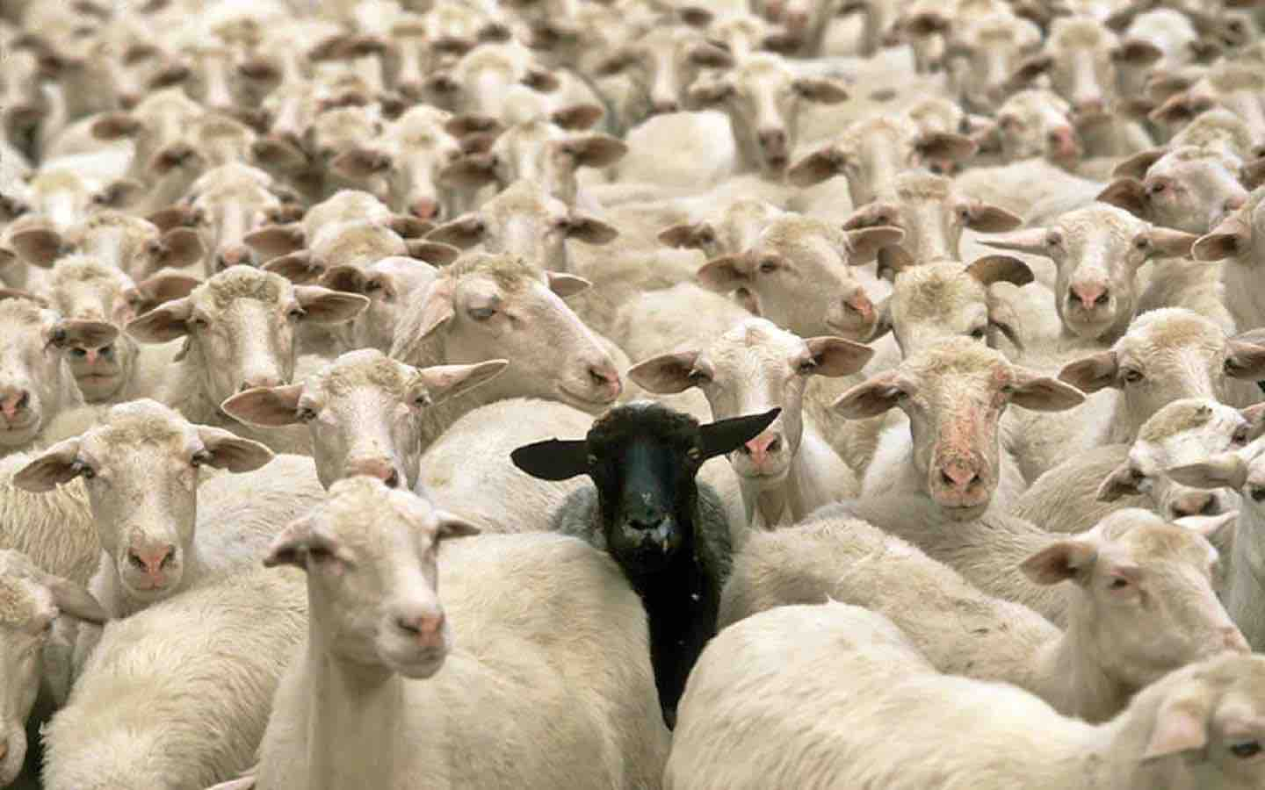
Saliency
Saliency is determined by local feature contrast.

Slide 4
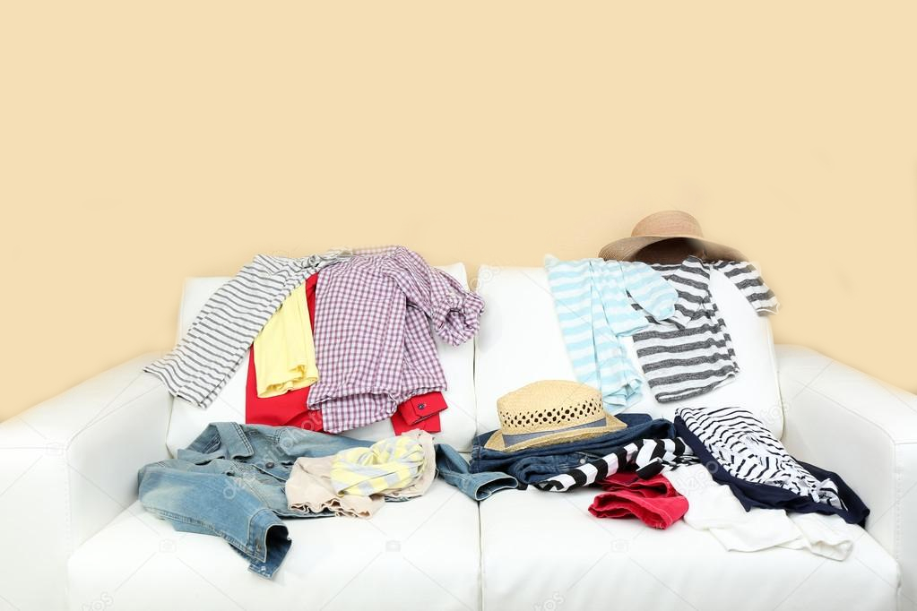
Saliency and VWM
Basic VWM study design focuses on isolated items (i.e. salient).
In more complex scenes, the saliency of each item might be the determinant of how much resource is allocated to them.

Slide 5
1st Experiment
How does saliency influence VWM performance?
Hypothesis: More salient targets are recalled more accurately.

Slide 6
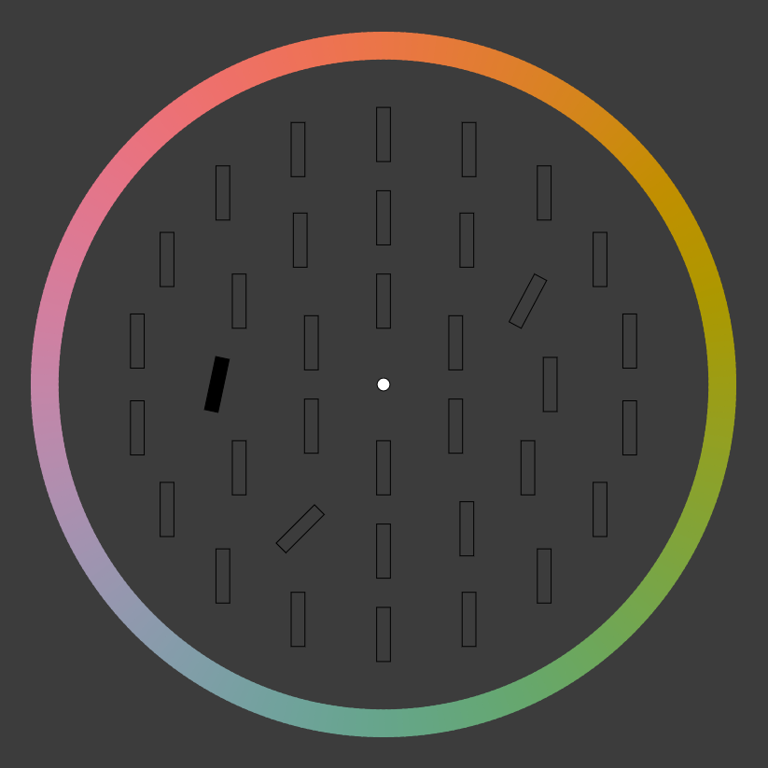
Methods
Targets: 3 tilted bars (12°, 28° & 45°).
All targets share the same relevance.
Stimulus presentation (350ms)
Response (infinite)

Slide 8
Results (N = 10)
Recall Error: average absolute angular distance.
Saliency improves VWM performance.

Slide 9
2nd Experiment
What happens when targets share the same saliency?
Hypothesis: Resources should be distributed more evenly.

Slide 10
Methods
Two types of displays: Mixed (similar to Exp 1) and Same (targets share the same tilt).

Slide 11
Results (N = 31)
Mixed: Replicated results of Exp. 1.
Same: Effect of saliency is present.
Performance increases for 12° targets in Same displays.
Performance decreases for 45° targets in Same displays.
Resources are more evenly distributed in Same displays.
*
*
*
*
*
*

Slide 12
3rd Experiment
Can small eccentricity variations influence VWM performance?
Hypothesis: Less eccentric targets are more salient and remembered more precisely.

Slide 13
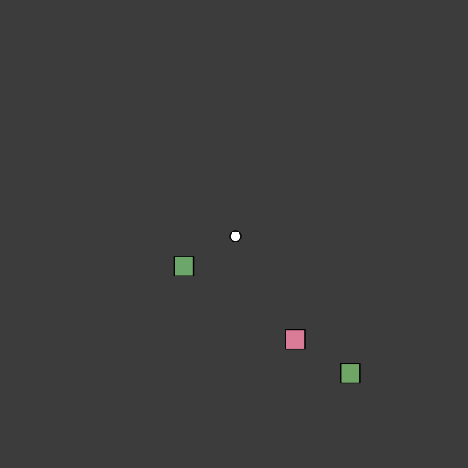
Methods
3 squares with eccentricity of 2°, 4° & 6°.

Slide 14
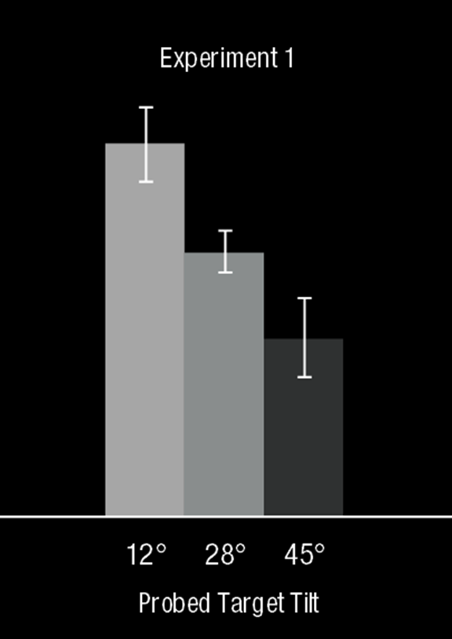
Results (N = 34)
More eccentric squares are recalled less precisely.
The effect is much weaker than the effect observed in Exp. 1.

Slide 15
Mid summary
More salient items receive more resources than less salient items.
Salient items receive more resources if presented among less salient items.
In traditional displays, small variations of saliency can influence performance.
Saliency influences VWM. How can this effect be modulated?
Constant & Liesefeld, preprint; under review.

Slide 16
4th Experiment
How does encoding time modulate the effect of saliency?
Hypothesis: VWM performance should increase with encoding time, especially for less salient targets.

Slide 17
Methods
7 encoding times: 14ms, 50ms, 100ms, 350ms, 500ms, 1000ms & 2000ms.

Slide 18
Results (N = 16)
For all tilts, performance improves with encoding time.
At 14ms, the most salient target is already well encoded.
The effect of saliency is still present with 2 seconds of encoding time.

Slide 19
Last experiment
Can relevance counteract the effect of saliency?
Hypothesis: Yes.

Slide 20
Methods
3 encoding times: 350ms, 2000ms & 3000ms.
Increased relevance of less salient targets.
12° targets probed on 3/6 of trials, 28° on 2/6 and 45° on 1/6.
Participants are aware of this distribution.
2/6
1/6
3/6

Slide 21
Results (N = 36)
At 350ms, the results are not different from previous experiments.
There is no difference between tilts at 2000ms or 3000ms.

Slide 22
Summary
The effect of saliency decreases over time.
Relevance can counteract saliency, in the right conditions.

Slide 23
Take home message
Saliency is an important factor influencing VWM performance that is hard to override.

Slide 24
Thank you
This project was supported by the German Research Foundation (DFG)
Martin.Constant@psy.lmu.de
Dr. Heinrich R. Liesefeld
https://psyarxiv.com/q36zu/

